Slide 1
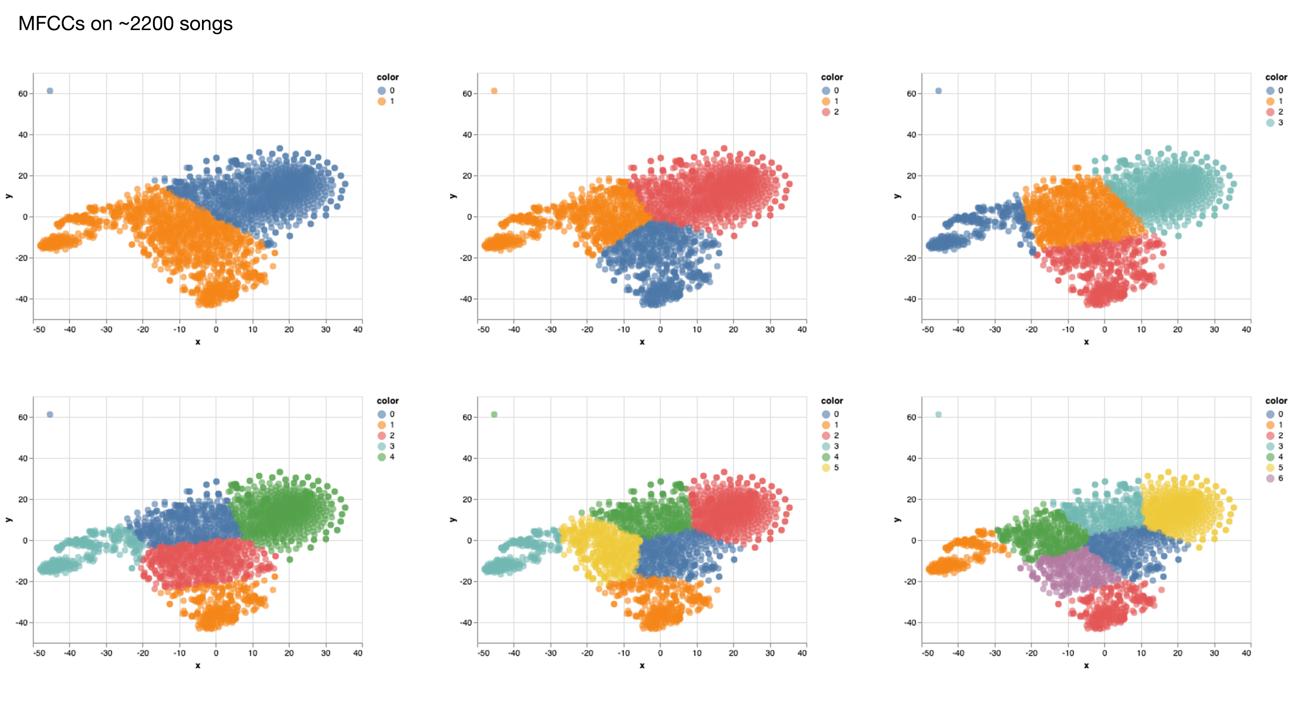

Slide 2
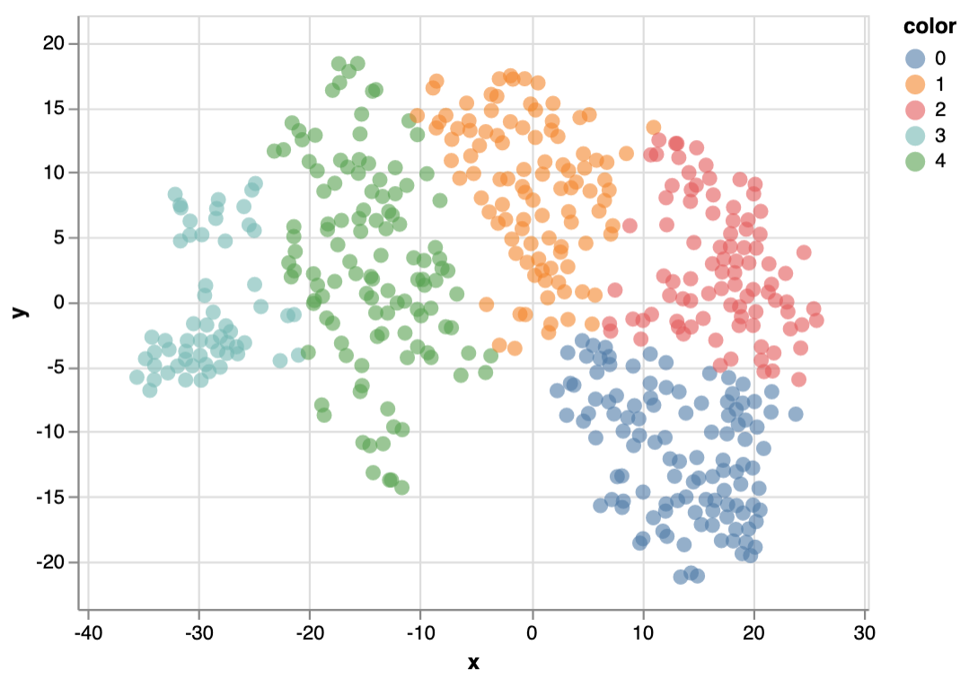
PCA 20 components on 483 songs

Slide 3
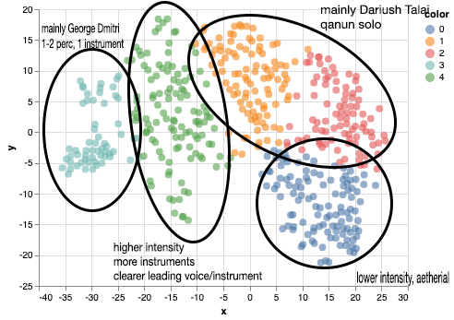
Insights from listening

Slide 4
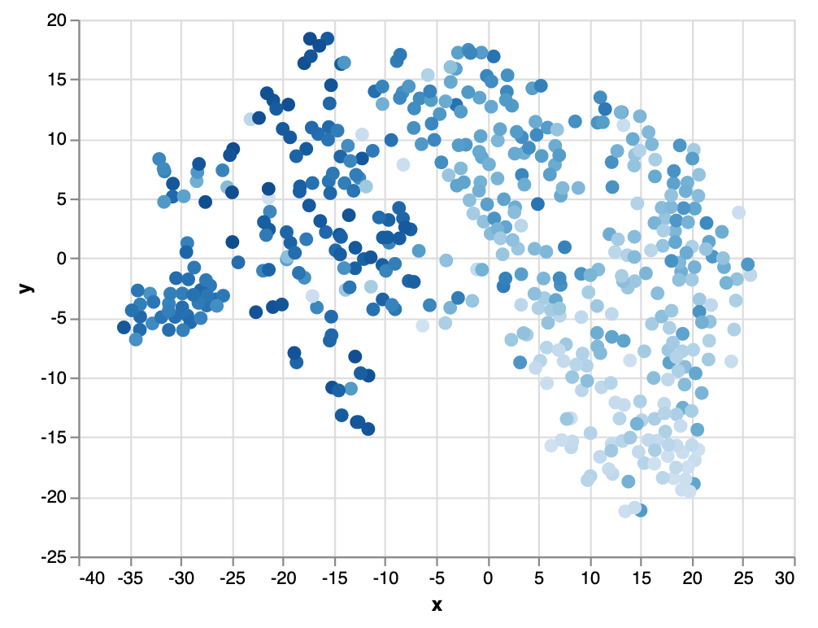
Insights from listening
Intensity

Slide 5
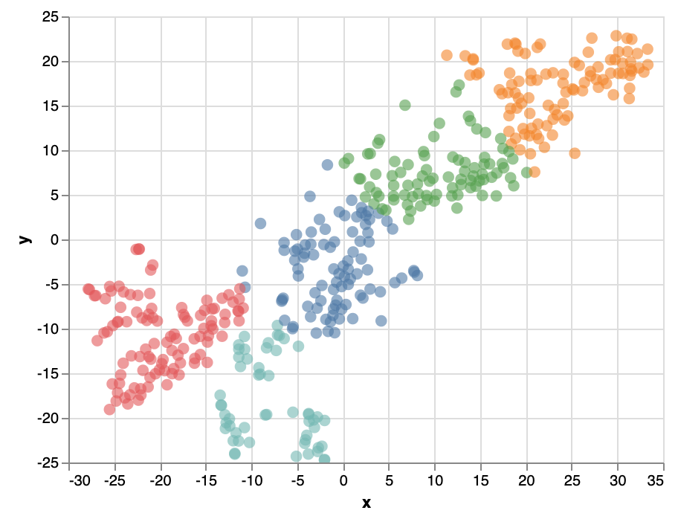
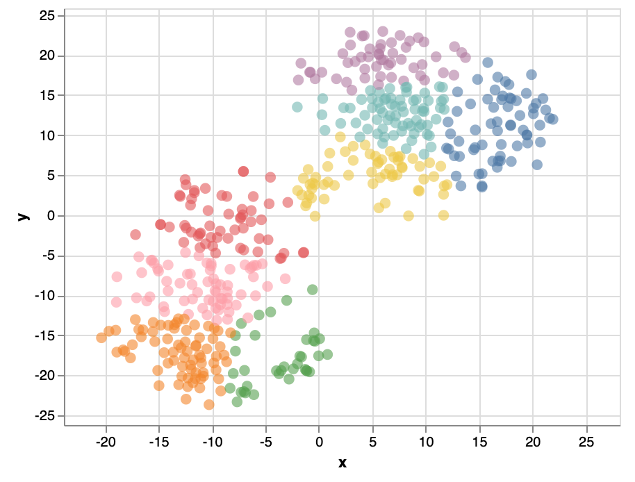
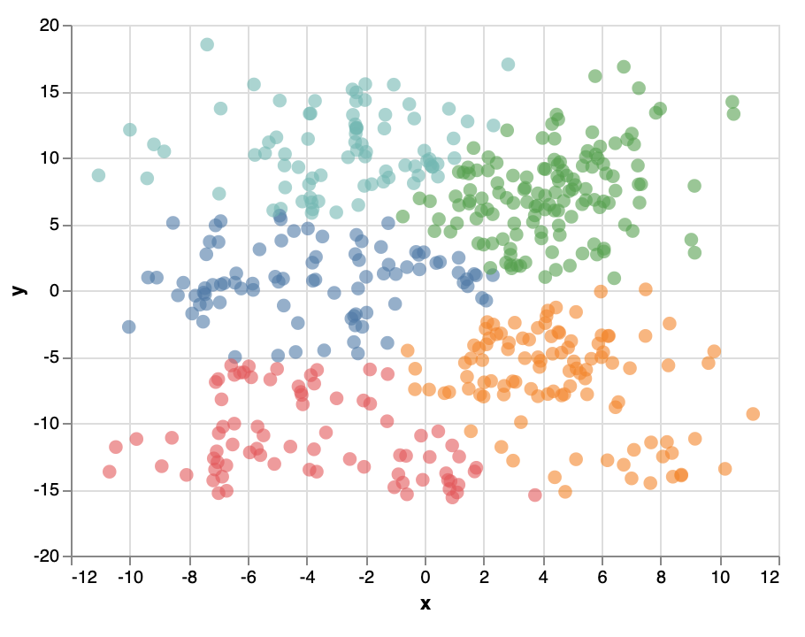
PCA 20
Autoencoder (71680, 2000, 100, 50, 100, 2000, 71680), 75 epochs
MFCC 20
Chroma Constant-Q & Tempogram

